Slide 1

Architecture Selection for API: Rest vs GraphQL
Team members: Arsalan Imran (002344722) Dan Luo (002352806) Guan Wang (002341590)

Slide 2

Introduction:
The choice of API architecture can significantly impact the performance, scalability, and overall user experience of an application. The decision between Rest and GraphQL often poses a significant challenge.

Slide 3

REST vs GRAPHQL
GraphQL was designed to allow the client to ask for only the data it needs. While the server might be able to deliver more data incase of rest to the client for a single request, it would only send the data that the client requests for graphQL.
GraphQL simplifies the task of aggregating data from multiple sources or APIs and then resolving the data to the client in a single API call. On the other hand, API technologies like REST would require multiple HTTP calls to access data from multiple sources.

Slide 4
REST vs GRAPHQL
REST offers a well-established approach based on resource-oriented principles, GraphQL introduces a more dynamic and efficient method for fetching data.
The biggest difference between GraphQL and REST is how data is sent to the client. In a REST architecture, the client makes an HTTP request and data is sent as an HTTP response, while in GraphQL, the client requests data with queries.
In REST, the structure of the request object is defined on the server. In GraphL, you define the object on the client.
It’s important to keep in mind that GraphQL is an alternative to REST for developing APIs, not a replacement.

Slide 5
In which cases graphQL is better than rest
Data fetching control
GraphQL provide better performance for amount of needed data, because it was designed to allow the client to ask for only the data it needs.
Using multiple data sources
Less http calls compared to rest which need more calls to access different entities. Graph can ask for data from multiple entities in one call.
Alleviating bandwidth concerns:
Since GraphQL responds more precisely compared to rest api, it will save more bandwidth and is more suitable for small devices.
Rapid prototyping
Change can be easier, and system are more flexible. For example, if your UI changes, requiring either more or less data, it doesn’t have an impact or require changes from the server.

Slide 6
In which cases rest is better than graphQL
Complex queries
a REST API might be easier to design because you can establish multiple endpoints for specific needs, and you can fine-tune specific queries to efficiently retrieve the data. For graphQL, if you're not careful, a few big queries can bring your server down dramatically.
For simple tasks
Using GraphQL in a simple application is not recommended. For example, in an application that uses a few fields the same way each time, using GraphQL adds more complexity because of things like types, queries, mutators, resolvers, and higher-order components. It increase the respond time

Slide 7

Objectives
Identify Use Cases: Identify specific use cases where REST or GraphQL architecture excels or faces challenges, which means evaluate the performance of each APIs under different scenarios and providing developers with practical guidance on architectural selection.
Metric Analysis: analyze key performance metrics such as average response times, throughput, data sent rate and data received rate for both REST and GraphQL architectures. The analysis of REST and GraphQL APIs will be done by its ability to handle increasing numbers of concurrent users and data requests.

Slide 8
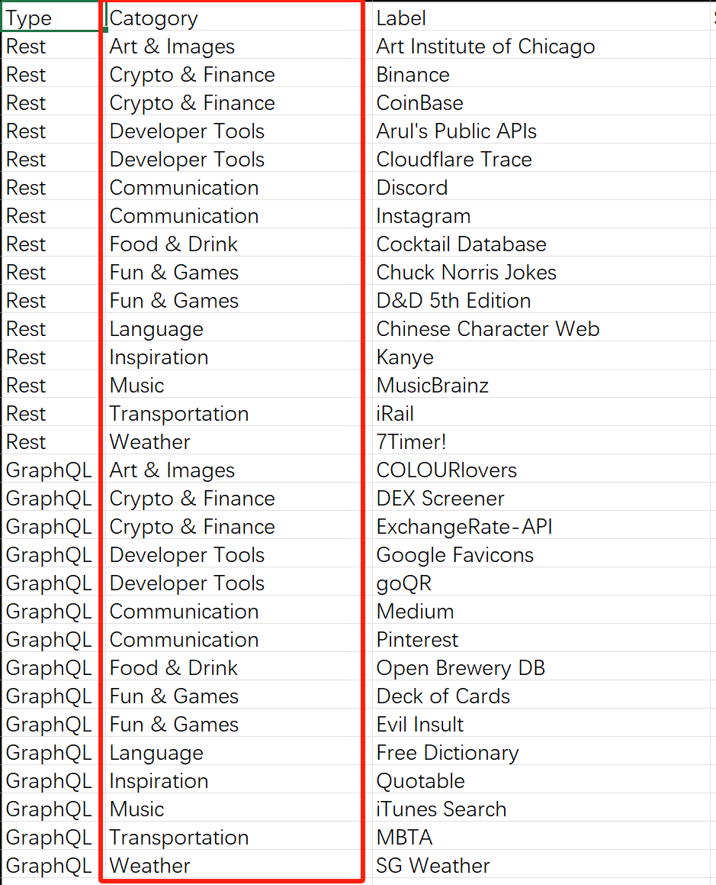

Use cases(Categories)

Slide 9
Methodology – Dataset Creation
We compile a dataset with comprehensive attribute including Api type, category, labels, num of users, average response time, category, errors, median, min response time, max response time, 20th percentile, 90%, 95%, 99% Line (Percentiles), Throughput, KB/sec (Kilobytes per second).
Five main features
User Number: Denotes the total number of samples executed for a particular label.
Category: The use case of Api in real world senario
Average Response Time (milliseconds): average duration taken for responses across all samples.
Error %: The percentage of requests that resulted in errors.
Throughput: Throughput is the rate of successful requests processed per unit of time.

Slide 10
Methodology - Analysis
Analysis: We will analyze the performance of Apis using the dataset and statistical analysis, including:
Multivariate Regression with User Count: Understand how user count affects API performance (e.g., error rate, average response time, throughput).
Comparative EDA Analysis of Two APIs' Categories: Understand the distribution and relative importance of categories for each API in the dataset.
Significance Testing for Error Rate (e.g., t-tests, Wilcoxon signed-rank tests): Identify if one API has significantly lower error rates.
Significance Testing for Throughput (e.g., t-tests, Wilcoxon signed-rank tests): Ascertain if there are significant differences in throughput data between the two APIs
Significance Testing for Average Response Time (e.g., t-tests, Wilcoxon signed-rank tests): Assess if one API consistently responds faster.

Slide 12
Methodology:
Validation: To validate our findings, we test publicly available REST and GraphQL APIs, corroborating dataset-derived insights with real-world observations.

Slide 13

Resources:
Language: Python
IDE: Jupyter Notebook
Libraries: Numpy, Pandas, PyTorch, transformers, datasets, matplotlib etc.,
Tools: JMeter and Chrome’s developer tool

Slide 14

Deliverables
Api performance dataset
Analysis Report
Feedback to users

Slide 15

References
https://stfalconcom.medium.com/understanding-api-performance-and-enhancing-its-efficiency-374c1a5ee865
https://blog.logrocket.com/graphql-vs-rest-api-why-you-shouldnt-use-graphql/

Slide 16

Thank you

